Slide 1

Predicting Breast Cancer Using
Multiple Clusterings Through DNA
Medimi Gagana Sree(1SJ23AD028)
K Chandra Priya(1SJ23AD021)
S Bhavya Sree(1SJ23AD051)
Pallavi B Gowda(1SJ23AD035)
Under the guidance of
Mr. Badrinath K
Assistant Professor, Dept of AI&DS,SJCIT

Slide 2
ABSTRACT
Breast cancer is a common disease, and early prediction can help in better treatment. Our project predicts breast cancer risk by analyzing DNA and SNP genetic data. Multiple clustering techniques are used to group individuals based on genetic similarities. The clusters are analyzed to identify genetic patterns associated with breast cancer.This system aims to support early risk assessment and better understanding of genetic factors.

Slide 3
INTRODUCTION
Breast cancer is one of the most common cancers affecting women worldwide.Early detection and risk prediction can help in providing timely treatment. DNA contains genetic information that can reveal variations related to diseases.SNPs (Single Nucleotide Polymorphisms) are small genetic variations that can be studied for this purpose. Our project analyzes SNP-based DNA data to identify patterns associated with breast cancer. Multiple clustering techniques are used to group individuals based on genetic similarities. The project aims to identify high-risk genetic patterns and support early breast cancer risk prediction.

Slide 4
IMPLEMENTATION
MODULES:
Module1: k-Means Clustering
Module2:Hierarchical Clustering
Module3:NMF(non-negative Matrix Factorization)
Module4:GNMF(Graph-based non-negative Matrix Factorization)

Slide 5
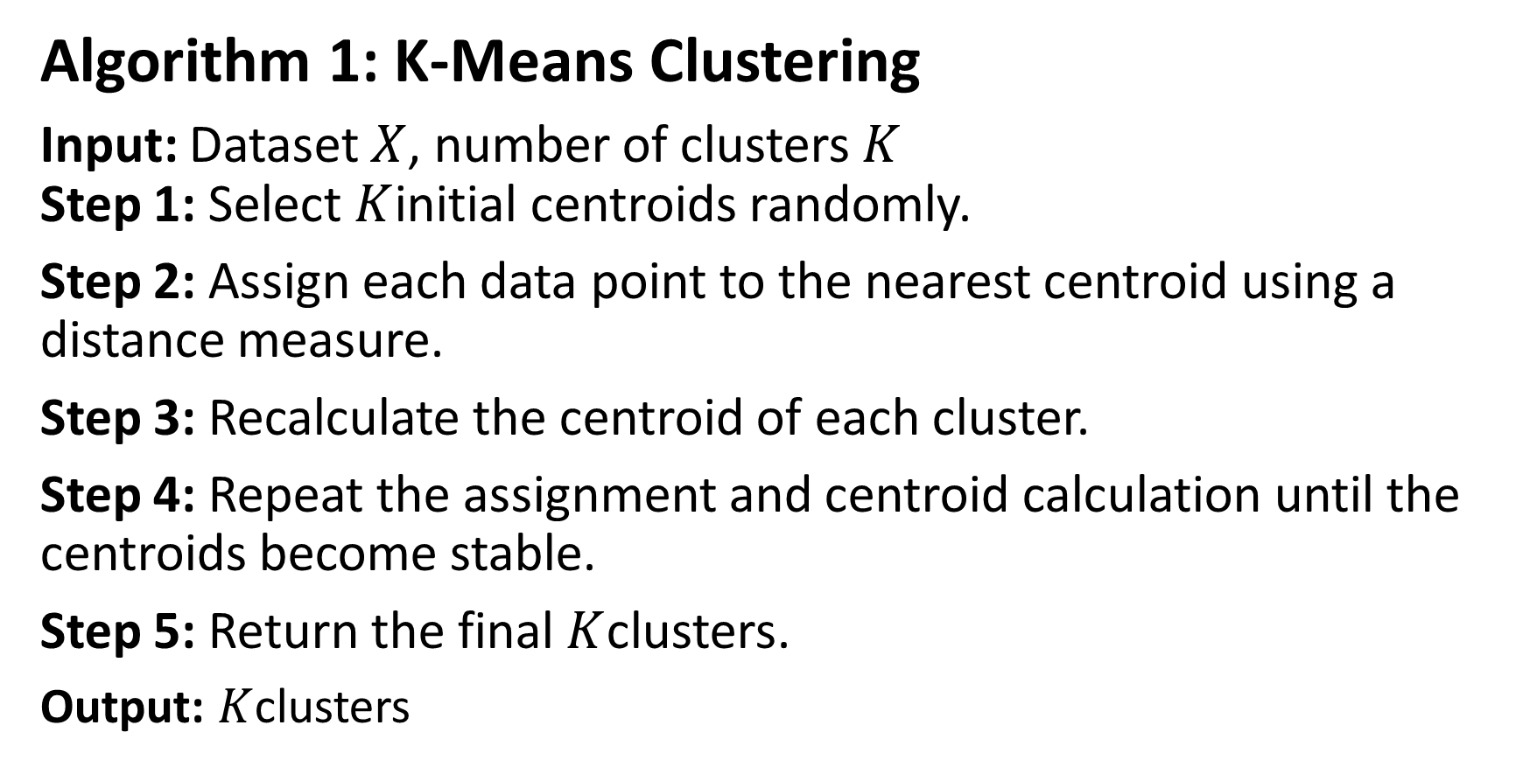
IMPLEMENTATION

Slide 6
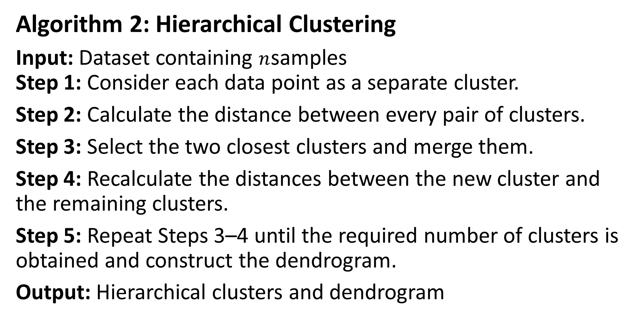

Slide 7
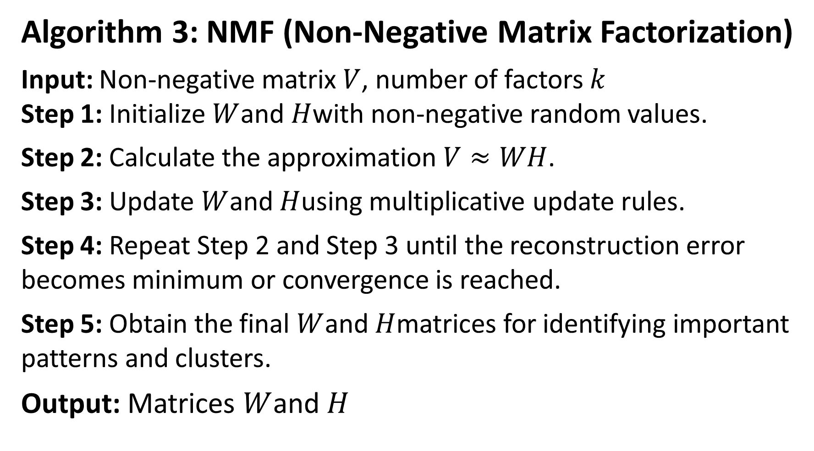

Slide 8
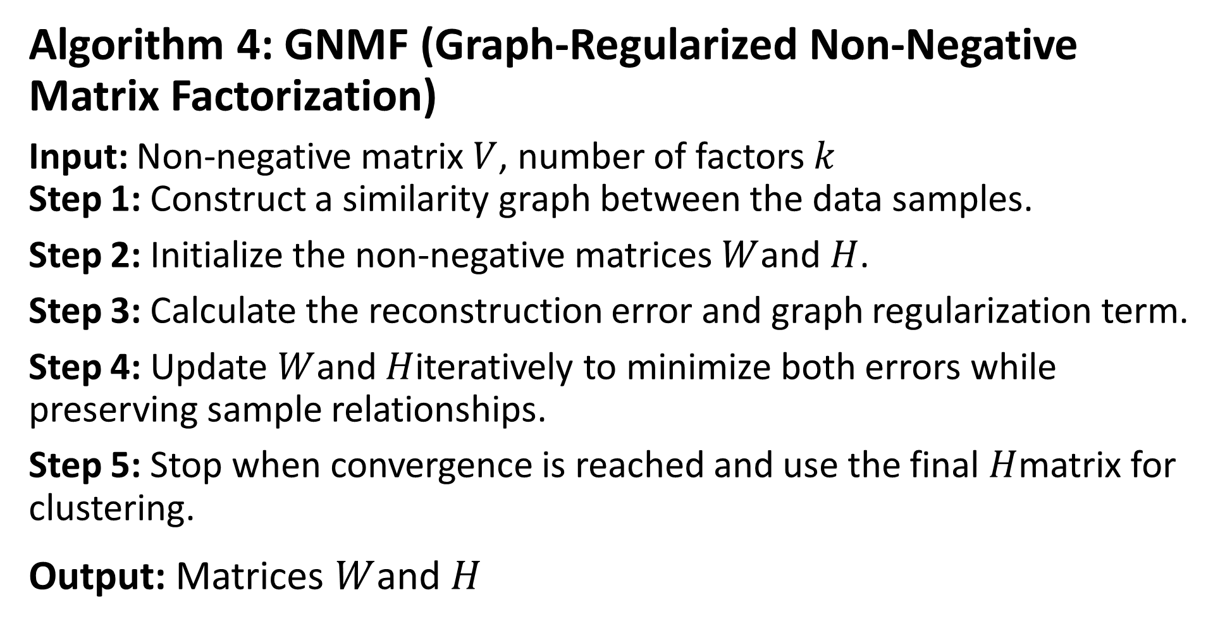

Slide 9
TESTING
1.UNIT TESTING
Test Case | Test Name | Test Description | Input | Expected Output | Actual Output | Test Result
UTC01 | DNA Dataset Loading | To verify whether the DNA dataset is loaded correctly. | Valid DNA/SNP dataset file | Dataset should be loaded successfully. | Dataset loaded successfully. | Success
UTC02 | DNA Data Preprocessing | To verify data cleaning and handling of missing values. | DNA dataset containing missing values | Missing values should be handled appropriately. | Data preprocessing completed successfully. | Success

Slide 10
UTC03 | SNP Data Encoding | To verify the conversion of SNP data into numerical format. | Valid SNP genotype values | SNP values should be encoded correctly. | SNP data encoded successfully. | Success
UTC04 | Multiple Clustering | To verify the grouping of similar DNA/SNP patterns using multiple clustering algorithms. | Preprocessed DNA/SNP features | Similar samples should be grouped into clusters. | Clusters generated successfully. | Success
UTC05 | Cluster Evaluation | To verify the quality of generated clusters. | Cluster labels and DNA/SNP features | Cluster quality should be evaluated using suitable metrics. | Cluster evaluation completed successfully. | Success
UTC06 | Breast Cancer Prediction | To verify the prediction generated by the trained model. | Valid patient DNA/SNP features | The model should generate a prediction. | Prediction generated successfully. | Success

Slide 11
2.INTEGRATED TESTING
Test Case | Details
Test Case | ITC01
Test Name | Module Interaction and Data Flow Validation
Test Description | To verify that all integrated modules function correctly and data flows smoothly between DNA dataset loading, preprocessing, multiple clustering, feature extraction, and breast cancer prediction components.
Input | DNA/SNP dataset containing patient samples and genetic features, followed by preprocessing, clustering, and prediction requests.
Expected Output | Successful dataset loading and preprocessing, correct execution of multiple clustering algorithms, identification of SNP patterns, and generation of breast cancer predictions by the trained model.
Actual Output | The integrated modules are expected to process DNA/SNP data sequentially and generate clustering results and prediction outputs without errors.
Test Result | Success (after successful execution and verification)

Slide 12
3.SYSTEM TESTING
Test Case | STC01
Test Name | End-to-End System Functionality Validation
Test Description | To verify that the fully integrated breast cancer prediction system performs all operations correctly, including DNA dataset upload, preprocessing, multiple clustering, SNP pattern analysis, and breast cancer prediction.
Input | DNA/SNP dataset containing multiple patient samples, genetic features, and relevant labels for model training and evaluation.
Expected Output | The system should complete the workflow, including dataset loading, preprocessing, multiple clustering, identification of genetic patterns, and display of breast cancer prediction results with stable performance.
Actual Output | The system processes DNA/SNP data, generates clustering results, and displays prediction outputs as expected.
Test Result | Success (after successful execution and verification)

Slide 13
CONCLUSION
The project “Predicting Breast Cancer Using Multiple Clustering Techniques Through DNA Data” aims to identify meaningful patterns in genetic data related to breast cancer. NMF, GNMF, Hierarchical Clustering, and K-Means are used to analyze and group similar DNA patterns. These techniques help in discovering hidden relationships and important features in the dataset. The proposed approach can support better understanding of genetic variations associated with breast cancer. Overall, the project demonstrates how machine learning and DNA analysis can be combined for breast cancer research and prediction.

Slide 14
FUTURE ENHANCEMENT
In the future, our project can be improved by using larger and more diverse breast cancer DNA datasets to increase the reliability of the system. Advanced deep learning techniques and Graph Neural Networks can be used to identify complex genetic interactions. The system can also be extended to detect interactions among three or more genetic markers. Biological information about genes and their pathways can be included to better understand the detected genetic patterns. We can further reduce computational time and improve the performance of the system. Finally, the project can be developed into a user-friendly application to help researchers analyze genetic data and support early breast cancer risk assessment.

Slide 15
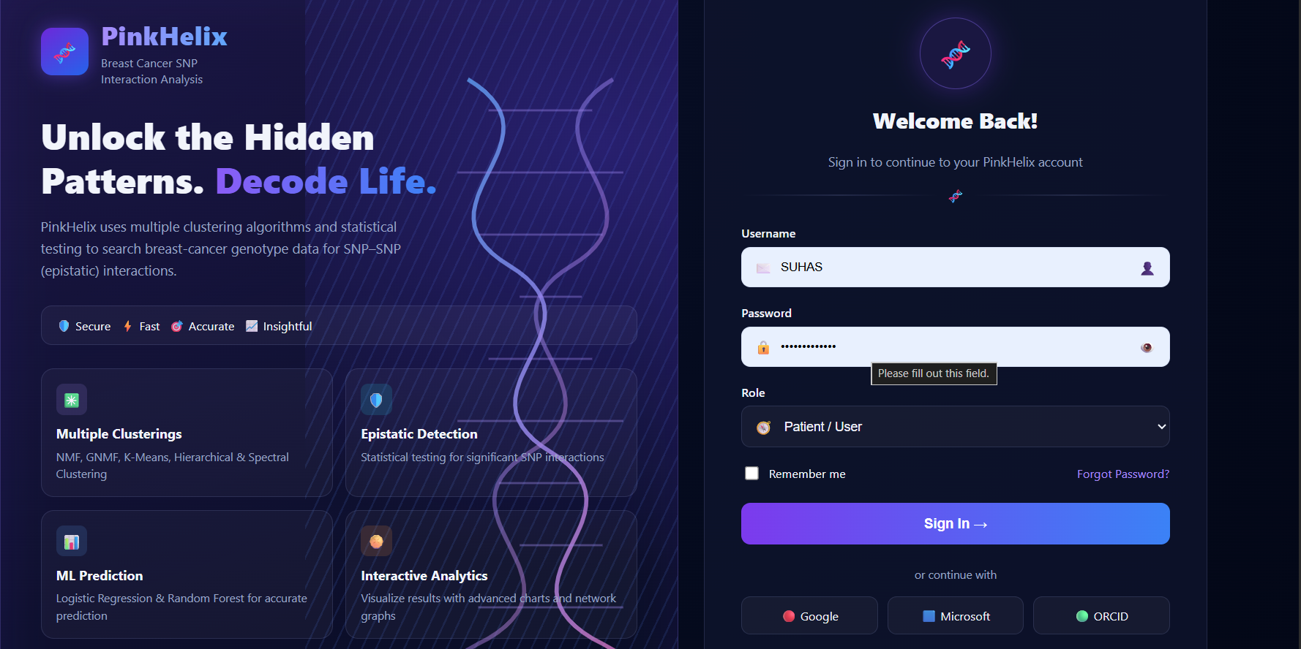
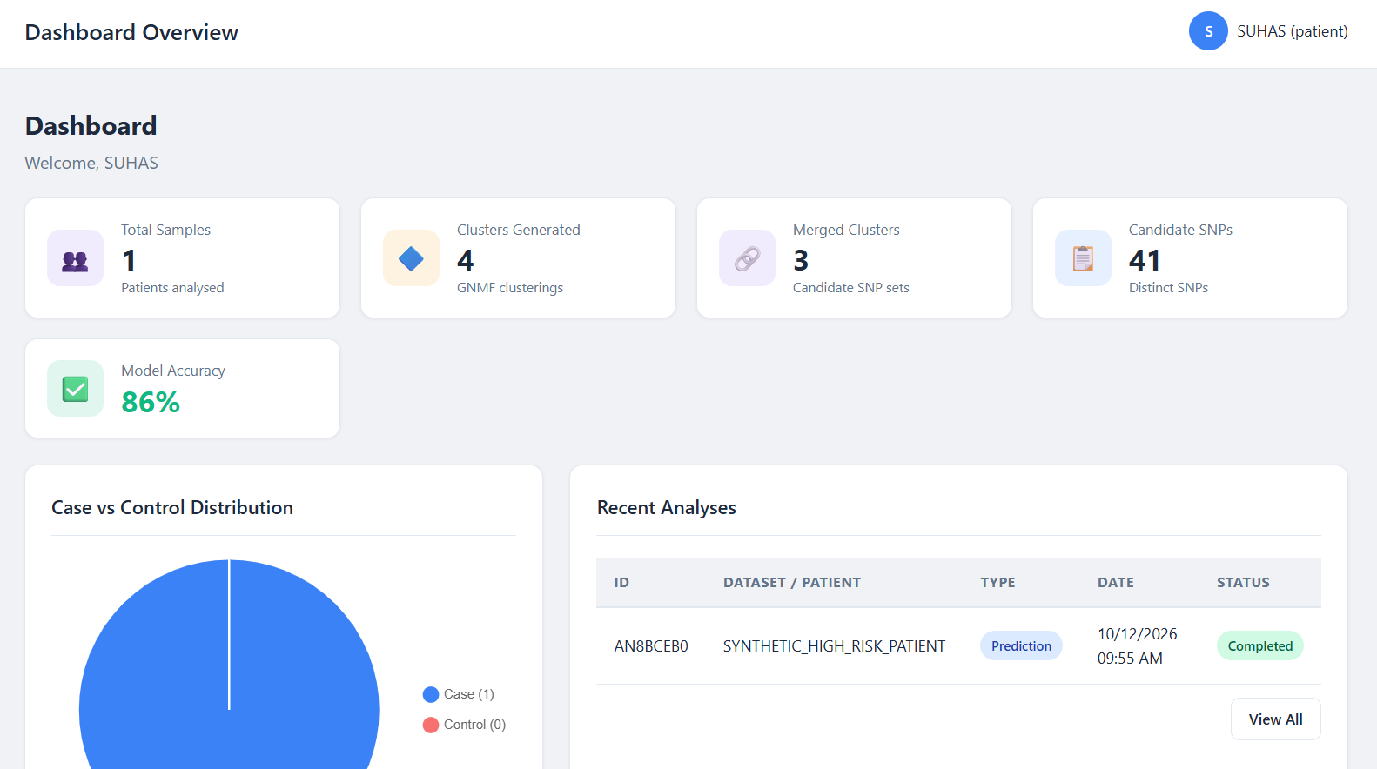
SNAP SHOTS
Fig1:Login page
Fig2: Dashboard

Slide 16
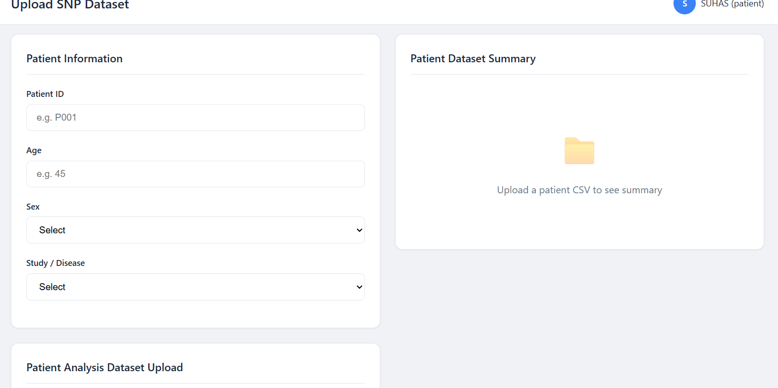
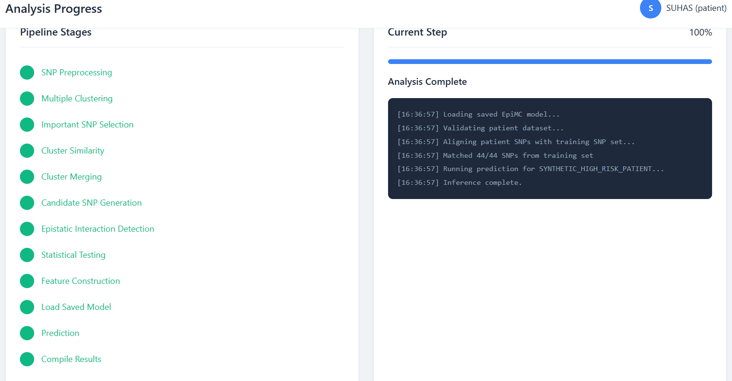
Fig3: Upload SNP Dataset
Fig4: Analysis Progress

Slide 17
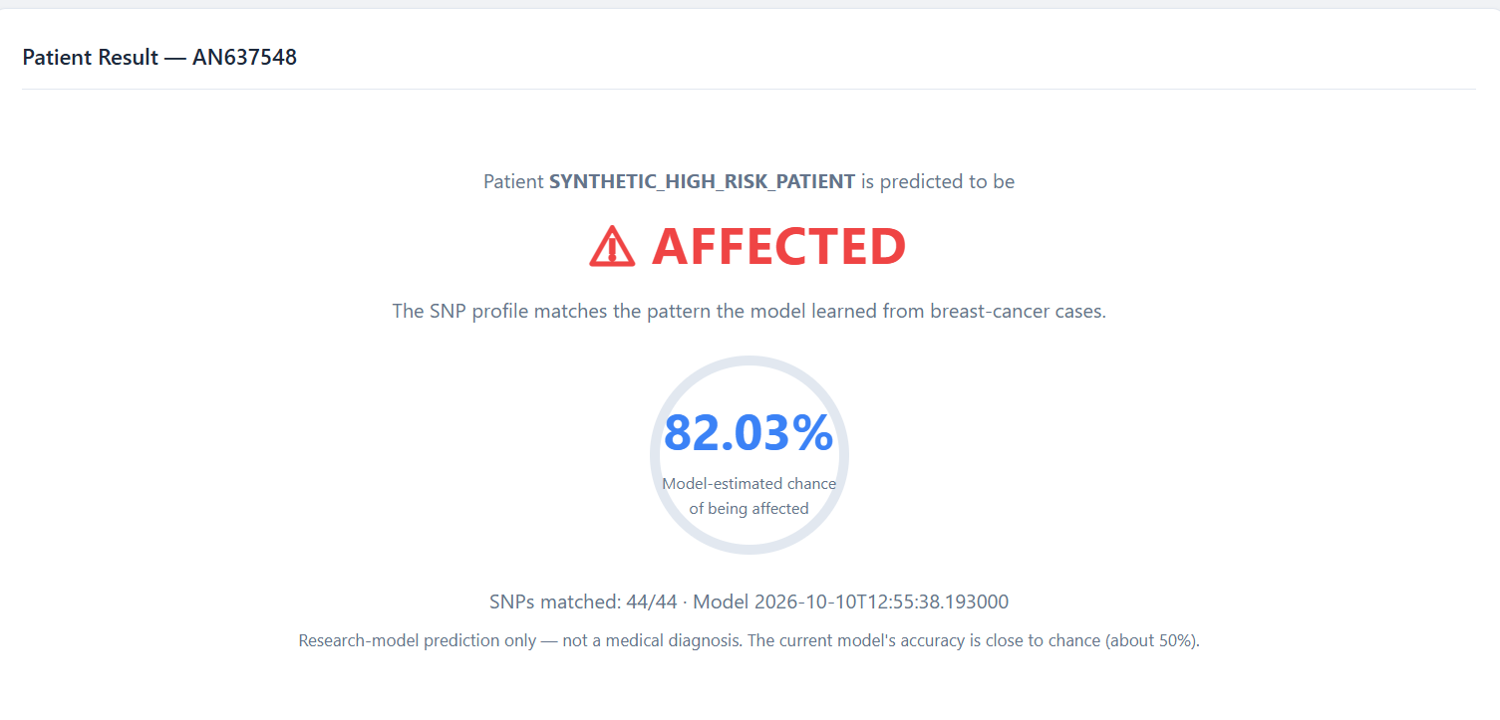
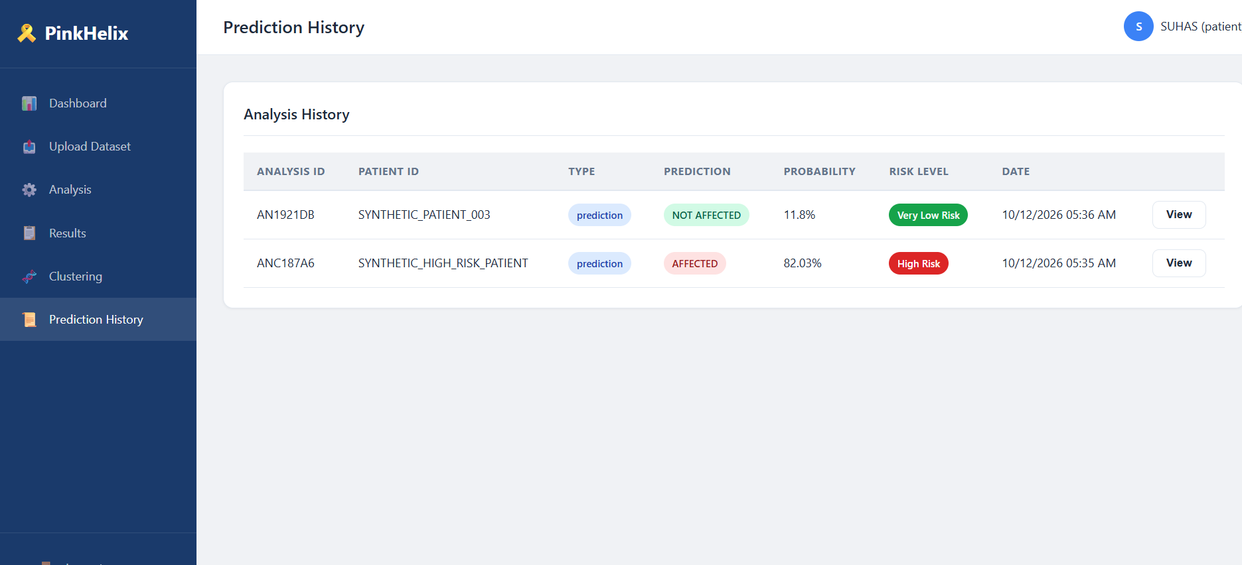
Fig5:Patient Result
Fig6:Prediction History

Slide 18
REFERENCES
[1]N. Cristianini and M. W. Hahn, Introduction to Computational Genomics: A Case Study in Cancer Research, Cambridge University Press, 2006.
[2]D. M. W. H. G. et al., “The Cancer Genome Atlas: A Comprehensive Multidimensional Map of the Genomic Landscape of Breast Cancer,” Nature, vol. 490, pp. 61–70, 2012.
[3]J. P. Brunet et al., “Metagenes and Molecular Pattern Discovery Using Matrix Factorization,” Proceedings of the National Academy of Sciences (PNAS), vol. 101, no. 12, pp. 4164–4169, 2004.

Slide 19
[4] C. S. Greene, N. M. Penrod, J. Kiralis, and J. H. Moore, "Spatially uniform ReliefF for computationally efficient filtering of gene–gene interactions," BioData Mining, vol. 2, no. 1, p. 5, 2009.
[5] X. Wan, C. Yang, Q. Yang, et al., "BOOST: a fast approach to detecting gene–gene interactions in genome-wide case-control studies," Am. J. Hum. Genet., vol. 87, no. 3, pp. 325–340, 2010.
[6] N. Cristianini and M. W. Hahn, Introduction to Computational Genomics: A Case Study in Cancer Research. Cambridge, U.K.: Cambridge Univ. Press, 2006

Slide 20
THANK YOU

